Slide 1
Intro to Deep Learning
Eng- Mohamed Khaled Idris
Eng- mayar swilam

Slide 2

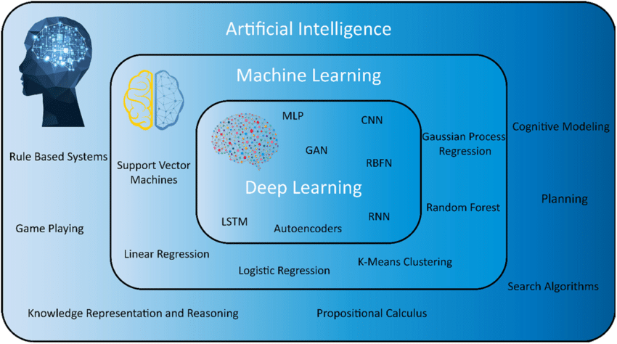

Slide 3
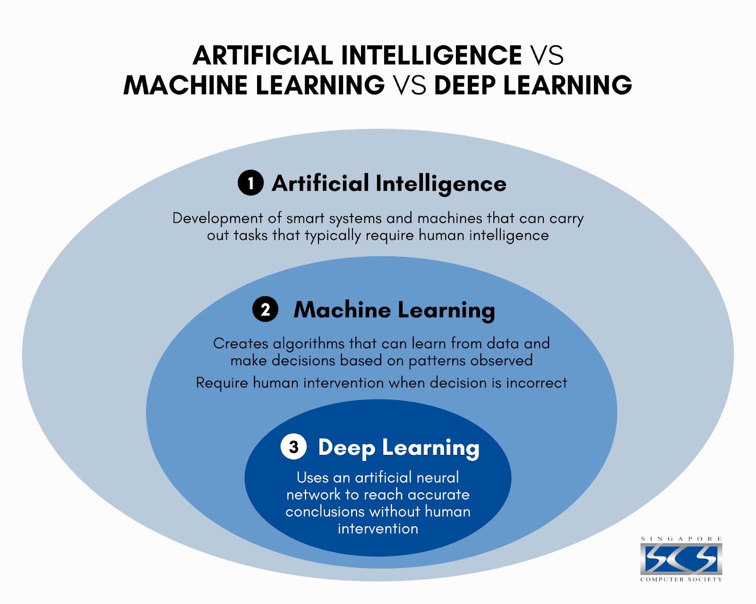

Slide 4
What is Deep Learning ?
Deep learning is a subset of machine learning that focuses on using ARTIFICIAL NEURAL NETWORKS (ANN) to model and solve complex patterns and representations in data.
It involves training neural networks with multiple layers (hence the term "deep") to automatically learn hierarchical features from raw data.

Slide 5
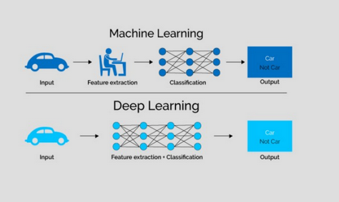
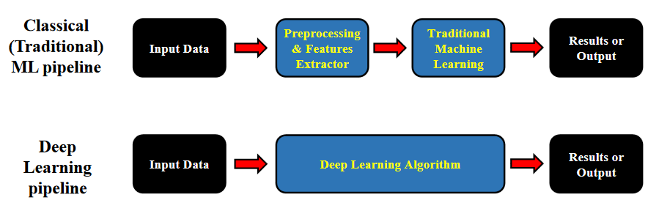
Classical ML Vs. DL

Slide 6
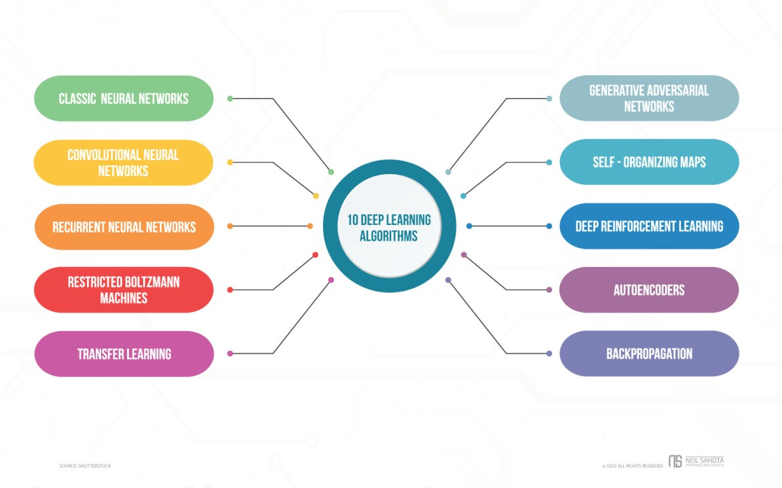

Slide 7
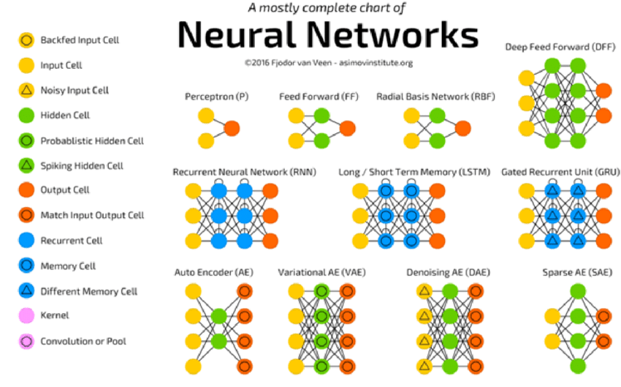

Slide 8
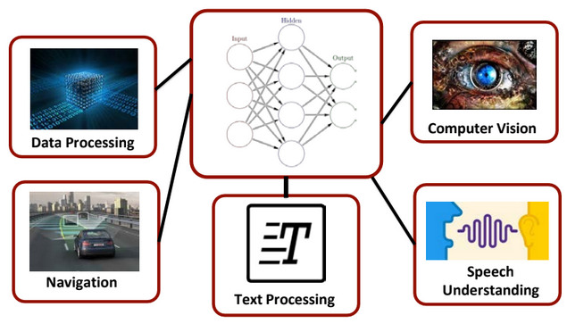
Fields of Deep Learning

Slide 9
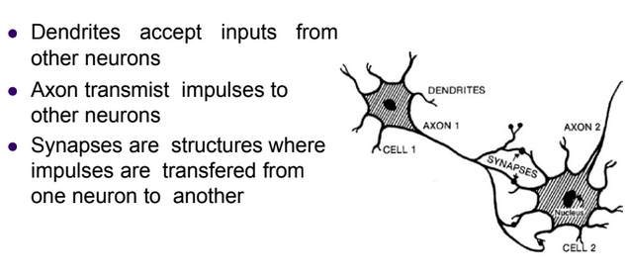
Inspiration
Biological Neural Network

Slide 10
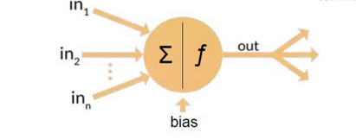
Inspiration (Cont.)
Artificial Neural Network

Slide 11
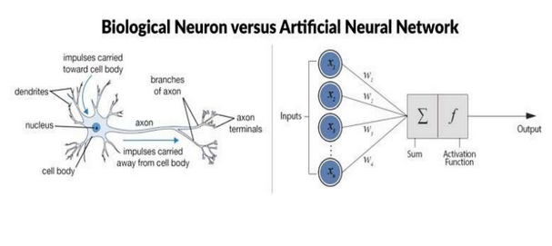

Slide 12
The Beginning: ANN
Neural networks are collections of thousands (or millions) of these simple processing units (neurons) that together perform useful computations.
ANNs can be represented using oriented graphs

Slide 13
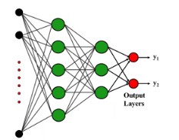

Slide 14
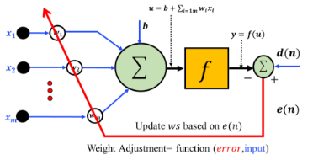
The Beginning: ANN (Cont.)
Neural network are parallel processing using highly nonlinear prediction functions
Neurons are nodes and they are activated based on the weighted sum of their inputs

Slide 15
Architectures

Slide 16
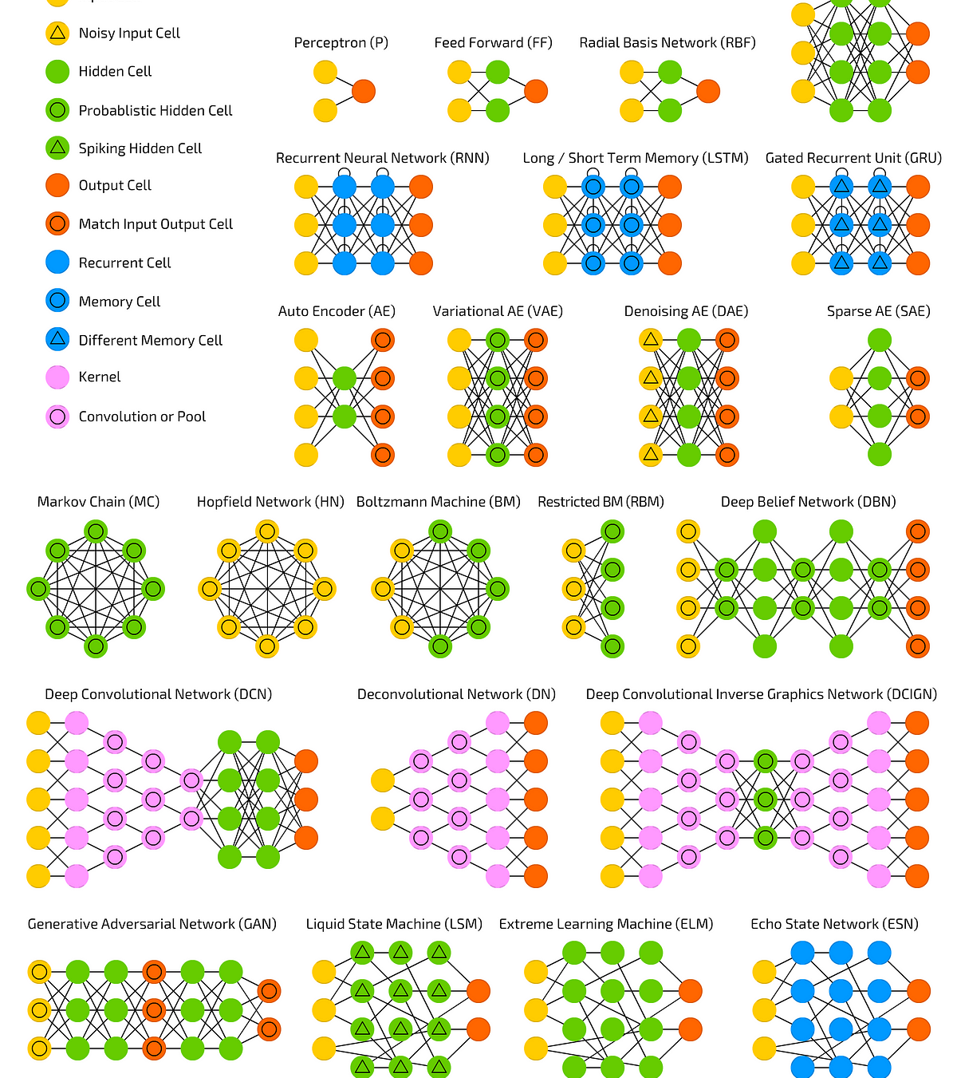
Many Architectures

Slide 17
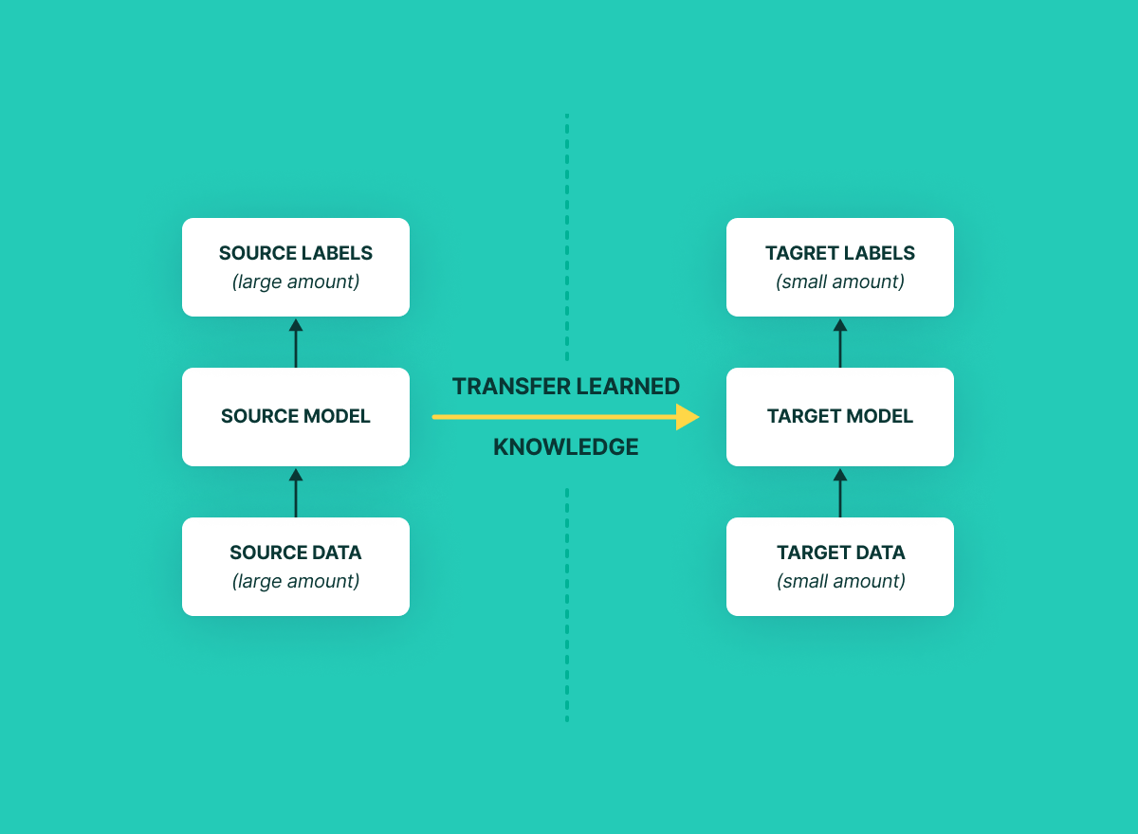
Transfer Learning

Slide 18
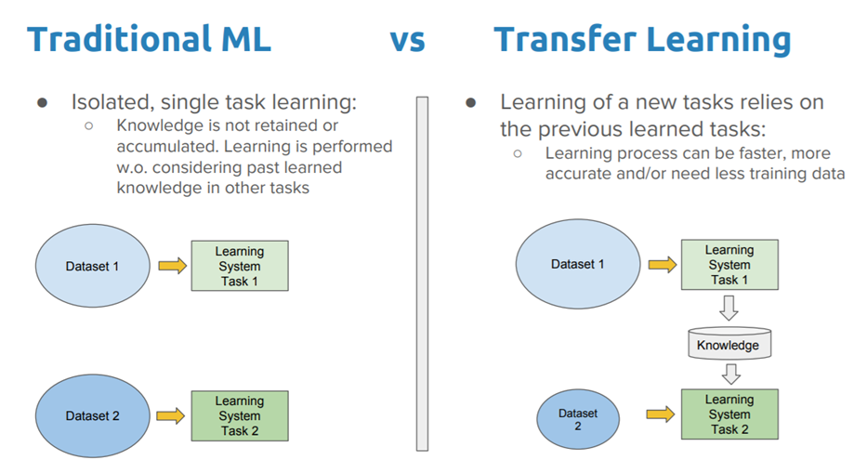
Traditional Learning VS. Transfer Learning

Slide 19
Generative AI

Slide 20
What is Generative AI ?
Generative AI, short for Generative Artificial Intelligence, refers to a field of artificial intelligence that focuses on creating models and algorithms capable of generating new, original data that resembles a given input dataset.
These models aim to capture and replicate patterns, styles, and characteristics present in the training data to produce new data samples that are similar in nature.
They were introduced by Ian Goodfellow and his colleagues in 2014. GANs consist of two neural networks, the generator, and the discriminator, which are trained simultaneously through adversarial training.

Slide 21
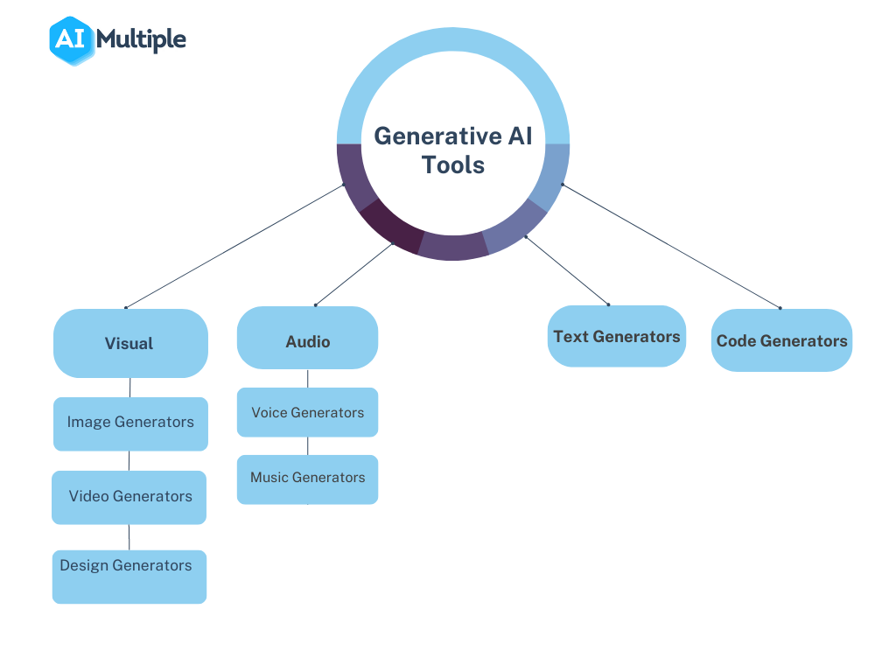

Slide 22
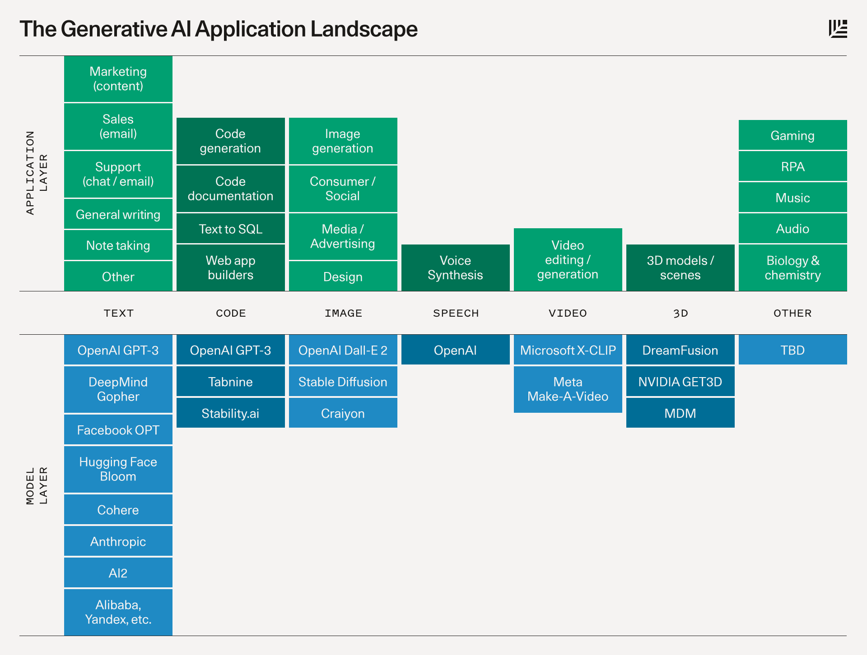

Slide 23
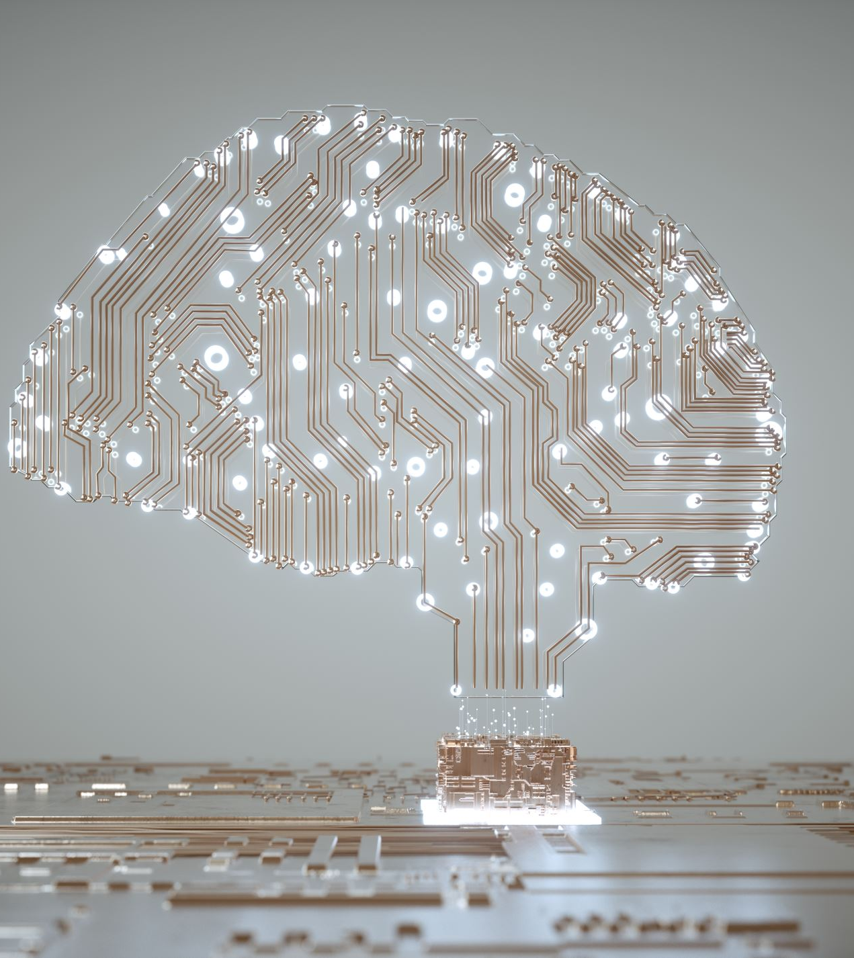
AI IS The Future

Slide 24

Questions

Slide 25
Thank you

